Slide 1
Recommendation Letter Request Form for Graduate School Application (1/2) NOTE: Recommendation letters will be directly given to graduate schools and programs from a recommender. The letters will not be given to students nor an external agent.
First name |  | Family name |  | Nickname (English)
Primary contacts: | Email: Tel.: |  | Alternative contacts: (e.g. Personal email, Tel.,)
Languages test scores | TOEFL: IELTS: |  | Graduate Entrance Exam scores | GRE: GMAT:
Whom do you want to get a recommendation letter?
What is your relationship with the recommender?
Did you take any course from the recommender? (specify it and tell what you achieved) |  | e.g.) MGS2150 W01 (Business Statistics) / 2017 Fall / A 1. 2. 3.
Why do you want to get a recommendation letter from the recommender?
Are you providing these necessary documents to the recommender? |  | _______ Statement of Purpose (Personal statement, Cover letter) _______ Curriculum Vitae (Resume) _______ Transcript (Unofficial is OK) _______ A sample recommendation letter or sentences _______ Evidences of job, internship, honors, award, grant etc.
What graduate programs do you apply for? (List them all) |  | e.g.) Master in XXX / University of XXX / Nation 1. 2. 3. 4. 5.
(Until) When do you want to get recommendation letter?
Which form of recommendation letter do you want to get? |  | _______ Online [Link(s) from Graduate schools via Email] _______ Signed & Sealed [Graduate School(s) addresses must be provided]
Form download: http://leadershipcenter.tistory.com/444

Slide 2
Recommendation Letter Request Form for Graduate School Application (2/2)
What is your purpose of applying for the graduate program(s)?
What is your (terminal) career goal after completing the graduate program?
Any sample sentences do you want to include in the recommendation letter?
Job or internship experiences?
Extracurricular activities?
Honors, Awards, Grant, or Scholarship?
Public service, Volunteering, or Military service?
Any further information or request?
Applicant’s sign: | I cordially request for a recommendation letter for my graduate school application. Sign: ___________________ Date: __________________
Recommender’s Decision: | _______ Yes, I will write a recommendation letter for the applicant. _______ I’m sorry but I cannot write a recommendation letter because Sign: ___________________ Date: __________________
Form download: http://leadershipcenter.tistory.com/444

Slide 3
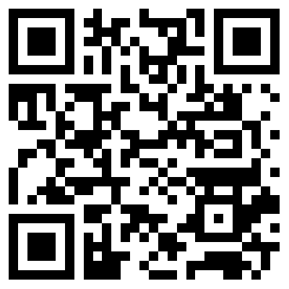
Recommendation Letter Request Form
is accessible at…
How to get a strong recommendation letter?
http://leadershipcenter.tistory.com/444

